Slide 1
PREPARED BY PARAS MALHOTRA
Customer Retention Case Study Presentation

Slide 2
AGENDA
Introduction
Problem Statement
Objective
Exploratory Data Analysis (EDA)
Visualization
Inference
Future Work

Slide 3
INTRODUCTION
What is Customer Retention and do we really need it?
“Customer retention refers to company’s ability to turn customers into repeat buyers and prevent them from switching to a competitor”
In other words customer retention means – “To maintain the existing customers”
This happens only if there exists a positive relation between the company and the customer.

Slide 4
What are the benefits of Customer Retention ?
Retained customers tend to buy other services from same company.
Retained customers are known to be less price/cost sensitive
The probability of selling to an existing customer is 60-70%
The probability of selling to new prospect is 5-20%
Declined migration rates
It’s more expensive to acquire a new customer than to retain an old one.

Slide 5
Tips for Succeeding at Customer Retention
Find out what customers want & what causes them to stay or leave ?
Proactively collect and promote customer feedback.
Analyze customer feedback to gain valuable insights and ensure the right people hear it.
Take action and Measure the results
Actively measure and monitor your customers’ loyalty and engagement
Keep asking, listening analyzing and improving

Slide 6
Motivation for the Problem Undertaken
Successful customer retention involves more than giving the customer what they expect.
Generating loyal advocates of the brand might mean exceeding customer expectations.
Creating customer loyalty puts 'customer value rather than maximizing profits and shareholder value at the center of business strategy’.
The key differentiation in a competitive environment is often the delivery of a consistently high standard of customer service.
Furthermore in the emerging world of Customer Success, retention is a major objective.

Slide 7
PROBLEM STATEMENT
Customer satisfaction has emerged as one of the most important factors that guarantee the success of online store; it has been posited as a key stimulant of purchase or repurchase intentions and customer loyalty.
A comprehensive review of the literature, theories and models have been carried out to propose the models for customer activation and customer retention.
Five major factors that contributed to the success of an e-commerce store have been identified as: service quality, system quality, information quality, trust and net benefit.
The research furthermore investigated the factors that influence the online customers repeat purchase intention.
The combination of both utilitarian value and hedonistic values are needed to affect the repeat purchase intention (loyalty) positively.
The data is collected from the Indian online shoppers. Results indicate the e-retail success factors, which are very much critical for customer satisfaction.

Slide 8
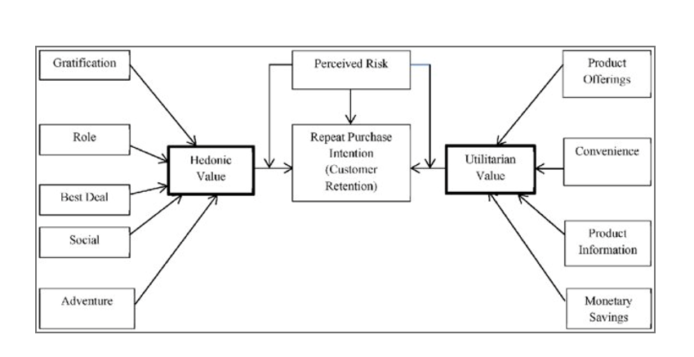
The problem statement can be represented in the form of below use case diagram as well.

Slide 9
E-retail factors for customer activation and retention: A case study from Indian e-commerce customers.
Customer satisfaction has emerged as one of the most important factors that guarantee the success of online store; it has been posited as a key stimulant of purchase, repurchase intentions and customer loyalty. A comprehensive review of the literature, theories and models have been carried out to propose the models for customer activation and customer retention. Five major factors that contributed to the success of an e-commerce store have been identified as: service quality, system quality, information quality, trust and net benefit. The research furthermore investigated the factors that influence the online customers repeat purchase intention. The combination of both utilitarian value and hedonistic values are needed to affect the repeat purchase intention (loyalty) positively. The data is collected from the Indian online shoppers. Results indicate the e-retail success factors, which are very much critical for customer satisfaction.

Slide 10
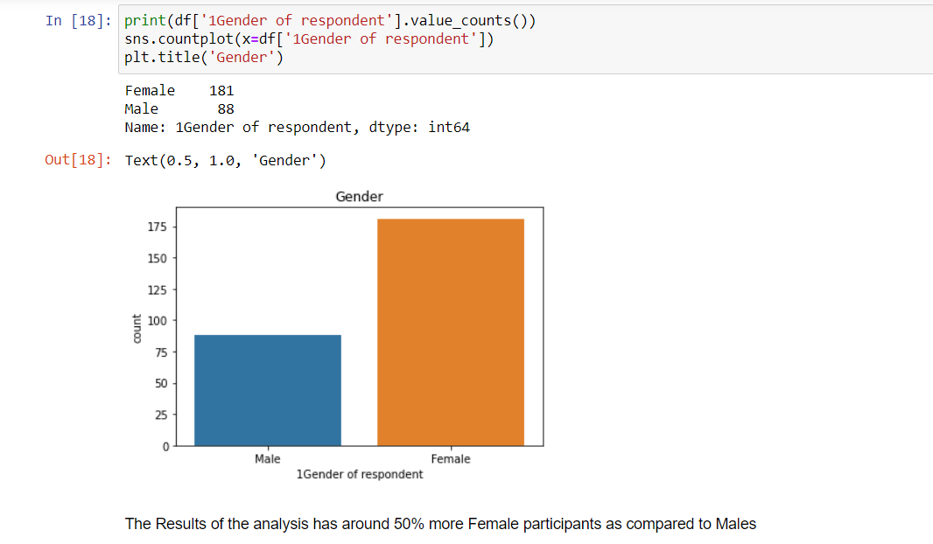

Slide 11
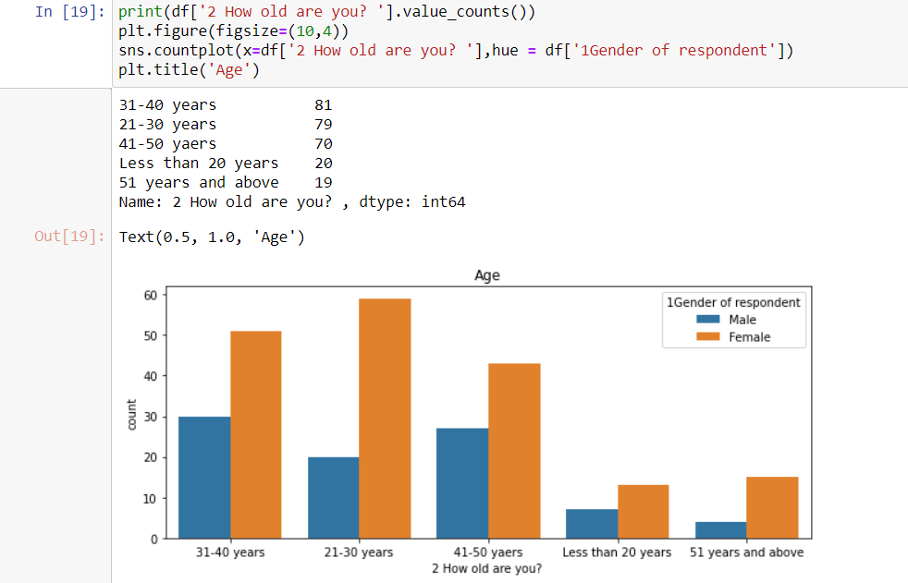

Slide 12
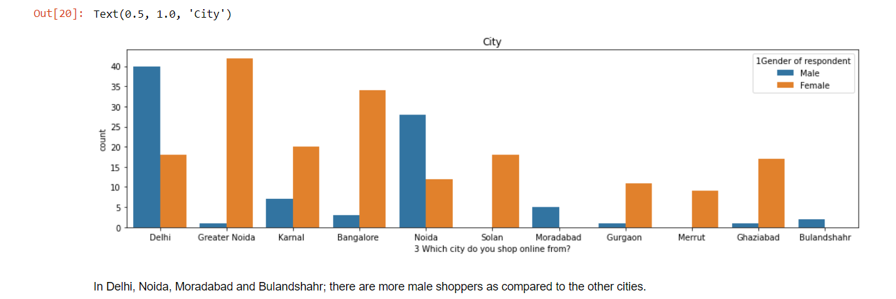

Slide 13
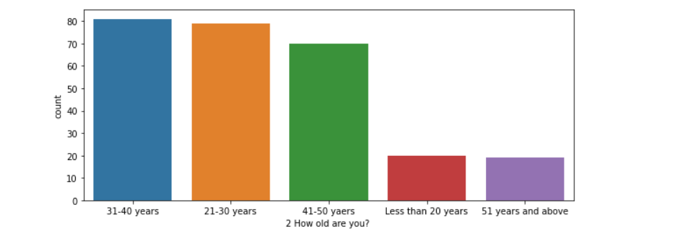

Slide 14
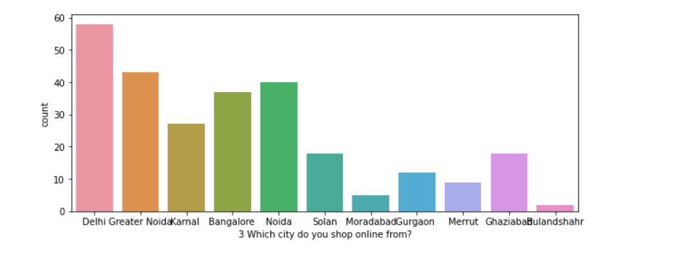

Slide 15
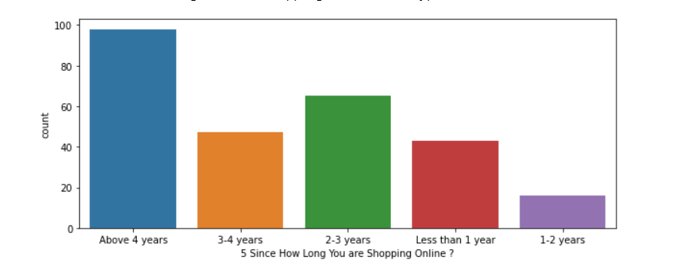

Slide 16
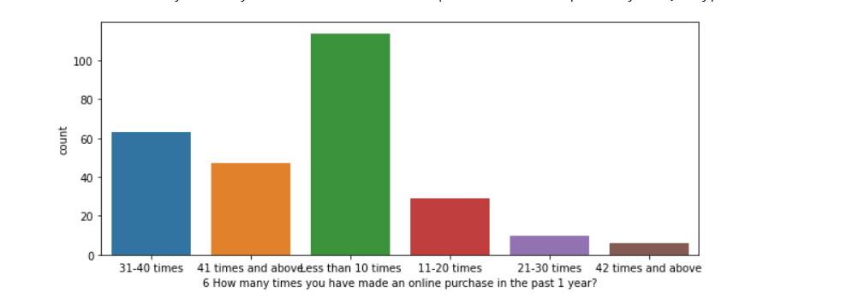

Slide 17
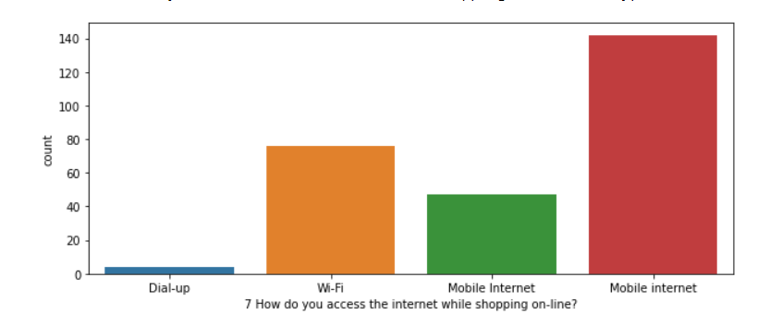

Slide 18
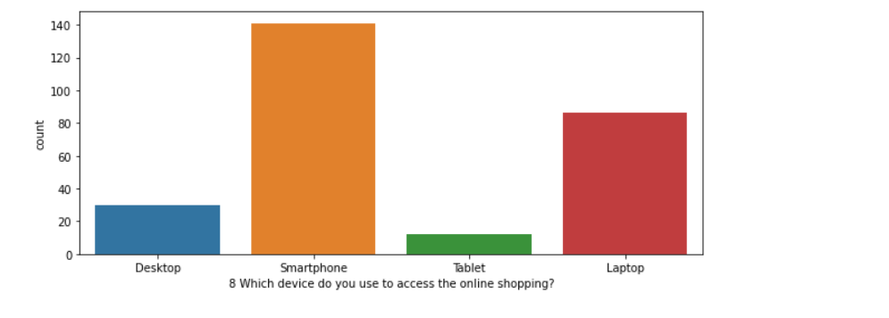

Slide 19
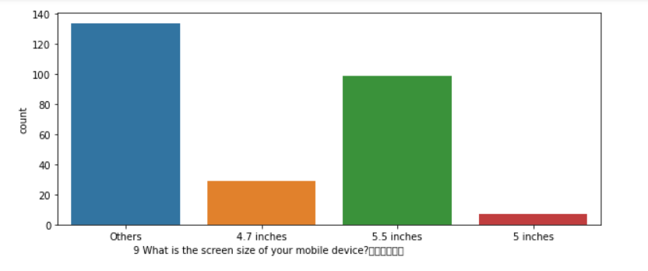

Slide 20
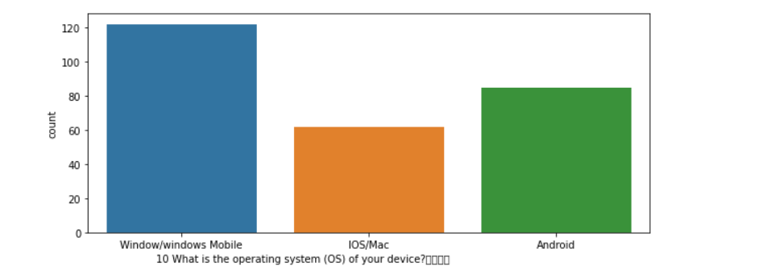

Slide 21
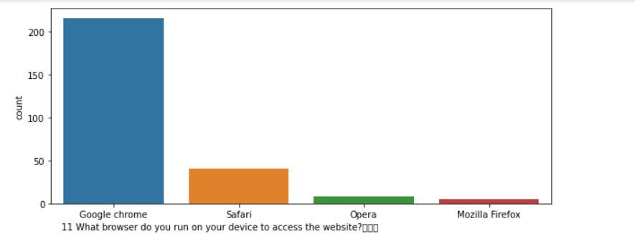

Slide 22
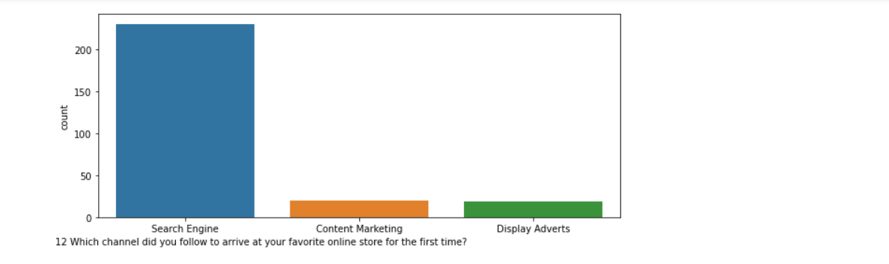

Slide 23
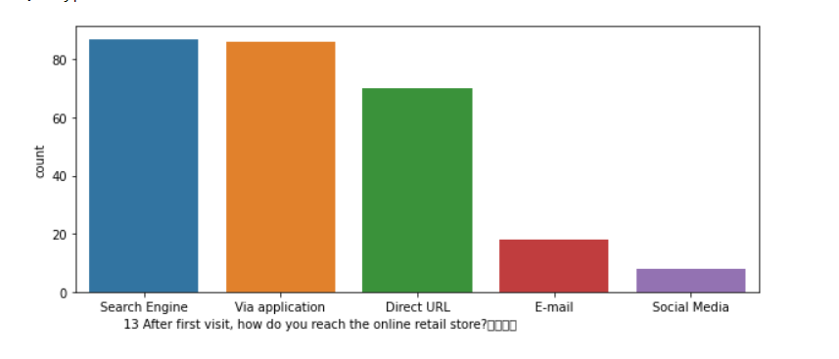

Slide 24
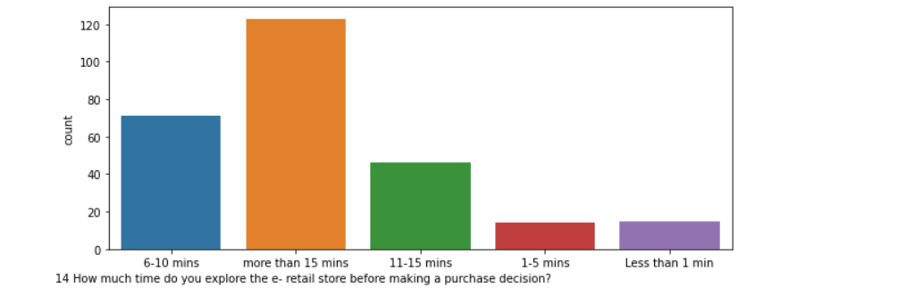

Slide 26
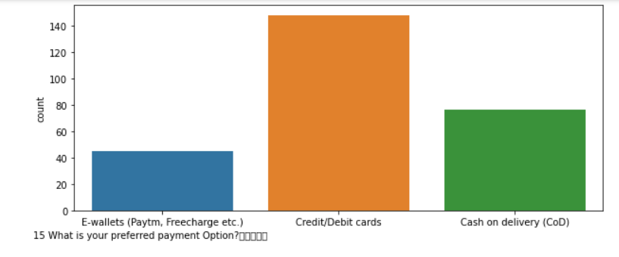

Slide 28
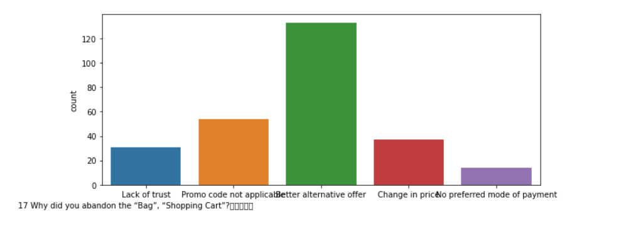

Slide 29
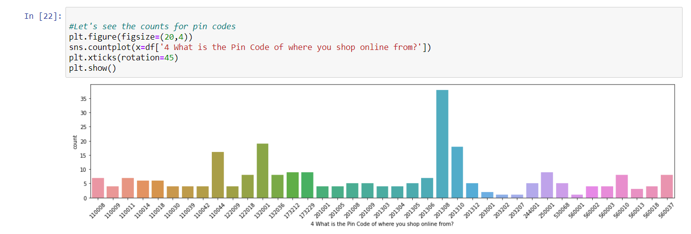

Slide 30
Observations from Multiple Options based Questions
Maximum people have shopped from these 5 companies - Amazon.in, Flipkart.com, Paytm.com, Myntra.com, Snapdeal.com.
Most people find Easy to use website or application are - Amazon.in, Flipkart.com, Paytm.com, Myntra.com, Snapdeal.com Also, Amazon.com and Flipkart.com are the major choices.
In terms of Visual appealing web-page layout also, Amazon.com and Flipkart.com seem to take the lead.
Talking about Wide variety of product on offer: Amazon.com and Flipkart.com are the major choices.
Complete, relevant description information of products: Once again, maximum people have chosen to go with mazon.com and Flipkart.com
Fast loading website speed of website and application: Amazon seems to take the lead in this category, although paytm and Flipkart are not far behind.
Reliability of the website or application: Amazon seems to take the lead in this category too, although Flipkart and paytm are not far behind.
Quickness to complete purchase: Amazon seems to take the lead in this category too, although Flipkart and paytm are not far behind.
Availability of several payment options: Here, Amazon and Flipkart, both are the favourites. Although a lot of people also tend to go towards Myntra
Speedy order delivery: Amazon seems to take the lead in this category too, followed by Flipkart.

Slide 31
Privacy of customers’ information: Amazon has a good reputation for maintaining privacy, followed by Flipkart
Security of customer financial information: Here other than Amazon and Flipkart, Paytm.com, Myntra.com, Snapdeal.com are also trusted by a lot of people. This shows that all compamnies pay special attention to security.
Perceived Trustworthiness: Amazon and Flipkart are winners here as well. Although Myntra.com and Snapdeal.com are also not far behind.
Presence of online assistance through multi-channel: Amazon.in, Flipkart.com, Myntra.com, Snapdeal
Longer time to get logged in (promotion, sales period): Amazon, paytm
Longer time in displaying graphics and photos (promotion, sales period): Amazon.in, Flipkart.com
Late declaration of price: Myntra, Paytm, Snapdeal. These companies should work on this area to improve.
Longer page loading time (promotion, sales period): Myntra and Paytm have bad feedback in this. Flipkart should also have a look into it, as it is at the 3rd place.
Limited mode of payment on most products (promotion, sales period): Snapdeal is the most voted answer for this.
Longer delivery period: Paytm and Snapdeal need to shorten their delivery time.
Change in website/Application design: Amazon.in
Frequent disruption when moving from one page to another: Amazon.in
Website is as efficient as before: Amazon.in
Which of the Indian online retailer would you recommend to a friend?: Amazon/Flipkart

Slide 32
Conclusion
Comparing the Customer's Perceptions and the Company's performance we can conclude that the Companies likely to have
High Customer Satisfaction and Retenton:
Amazon.com Flipkart.com High Risk of Customer Churn:
Myntra.com Snapdeal.com

Slide 33
THANK YOU

